Slide 1
Helping Students Transition Into Online Courses
Modeling Skill Sets
Organizing & Focusing
Unpacking and Chunking Assignments
Presentation by: Xinia Foster
FIU English Department
Writing and Rhetoric

Slide 2
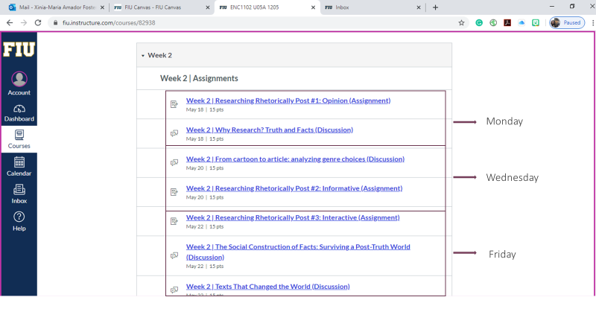
Organizing & Focusing Students

Slide 3
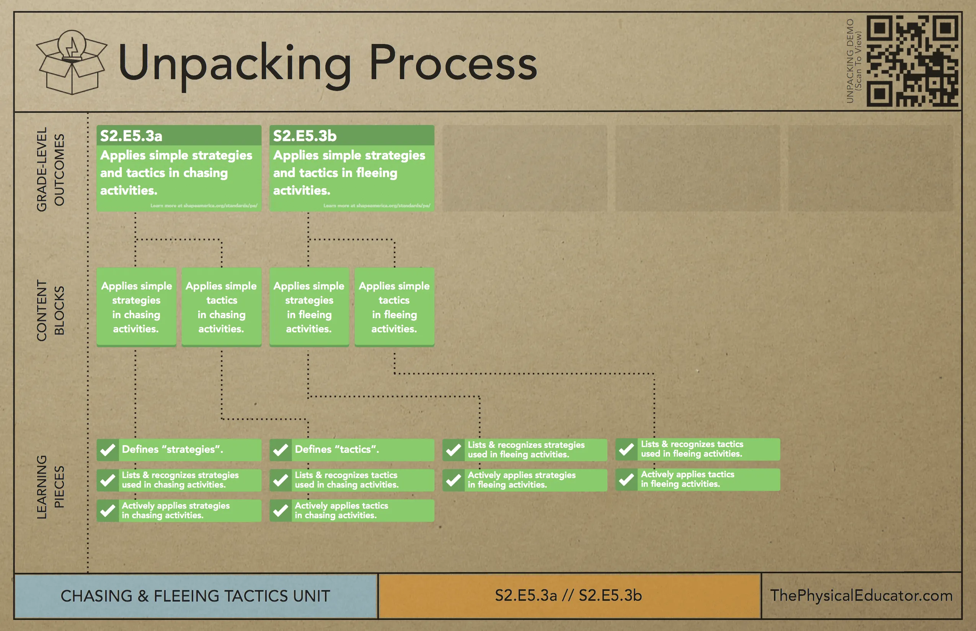
Scan Assignment sheet
Read the assignment one time to become familiar with the assignment.
Then re-read the assignment for big picture information: outcomes/expectations/tasks
Chunking the assignment
Modeling Unpacking Assignments

Slide 4
“Simplify, simplify.” Henry David Thoreau
In other words…
Task:
I’m going to follow a conversation of a social movement or influential organizations
I should look to see HOW they are responding
Questions To Address:
What specific conversation am I going to follow?
Think about why am I selecting this particular conversation?
What connection does this organization/movement have to me on personal, academic, and/or professional level?
Discussion Portion
Comment on two classmates’ posts.
What is interesting about their post?
Do I feel their topic matches the assignment sheet (be specific)?
How their topic can be refined, improved, rethought?
Model Chunking an Assignment

