Slide 1
Improving Communication: Audio Announcements
Judith Mansilla, Department of History

Slide 2
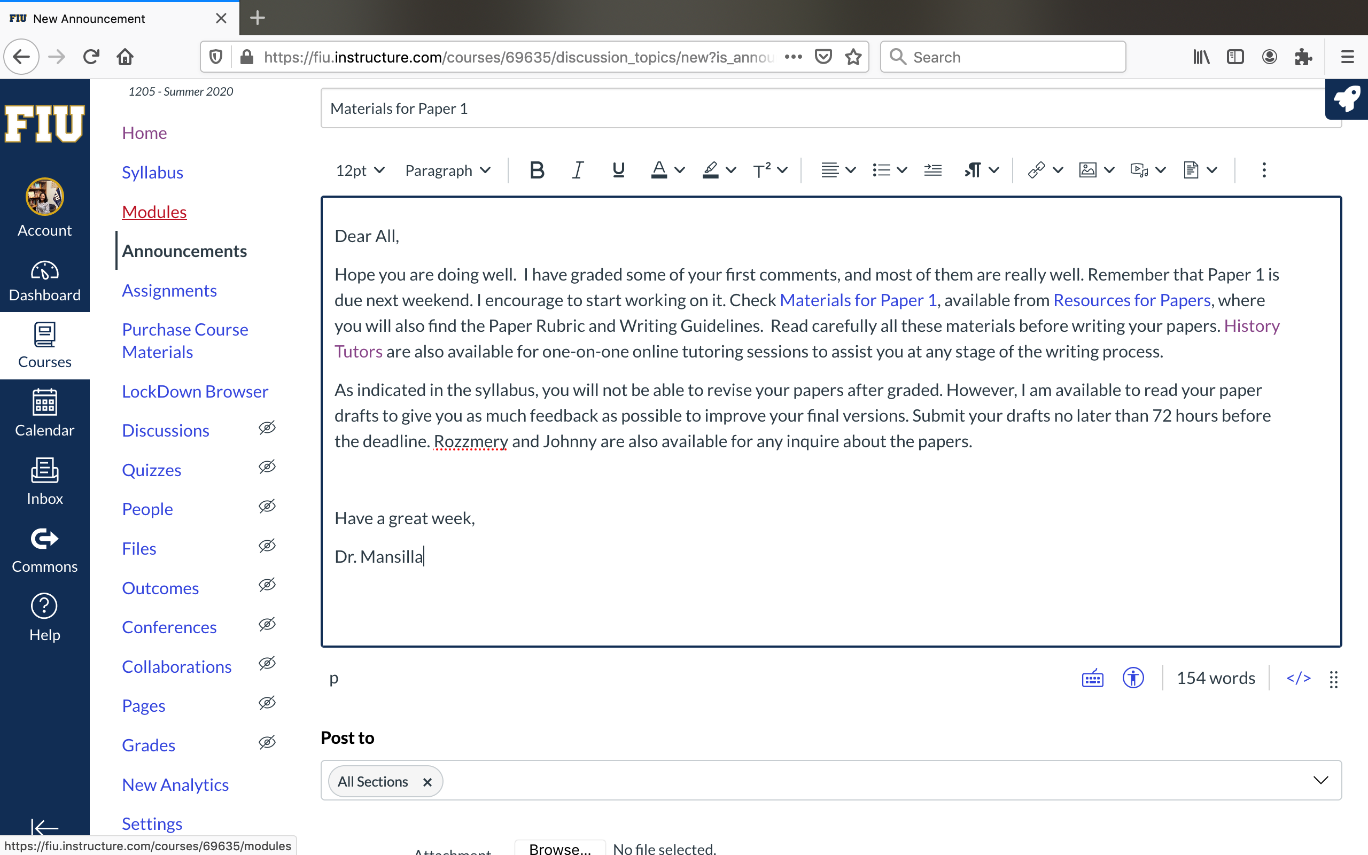
Announcements provide information to students. But do they read them if they are long?

Slide 3
Record your announcements with Canvas Record Media option

Slide 4
Students can listen announcement. If something was not clear, they can listen again the audio or read the announcement.
Very helpful! Students react to the announcements super quick!

